Slide 1
Instructions for UV2026 Paper Review & Assignment on EasyChair
- Session Chair

Slide 2
Outline
Account login [Slide 3]
Assign papers to reviewers as a session chair [Slide 6]
Review papers as a session chair [Slide 12]
Check the review result as a session chair [Slide 18]

Slide 3
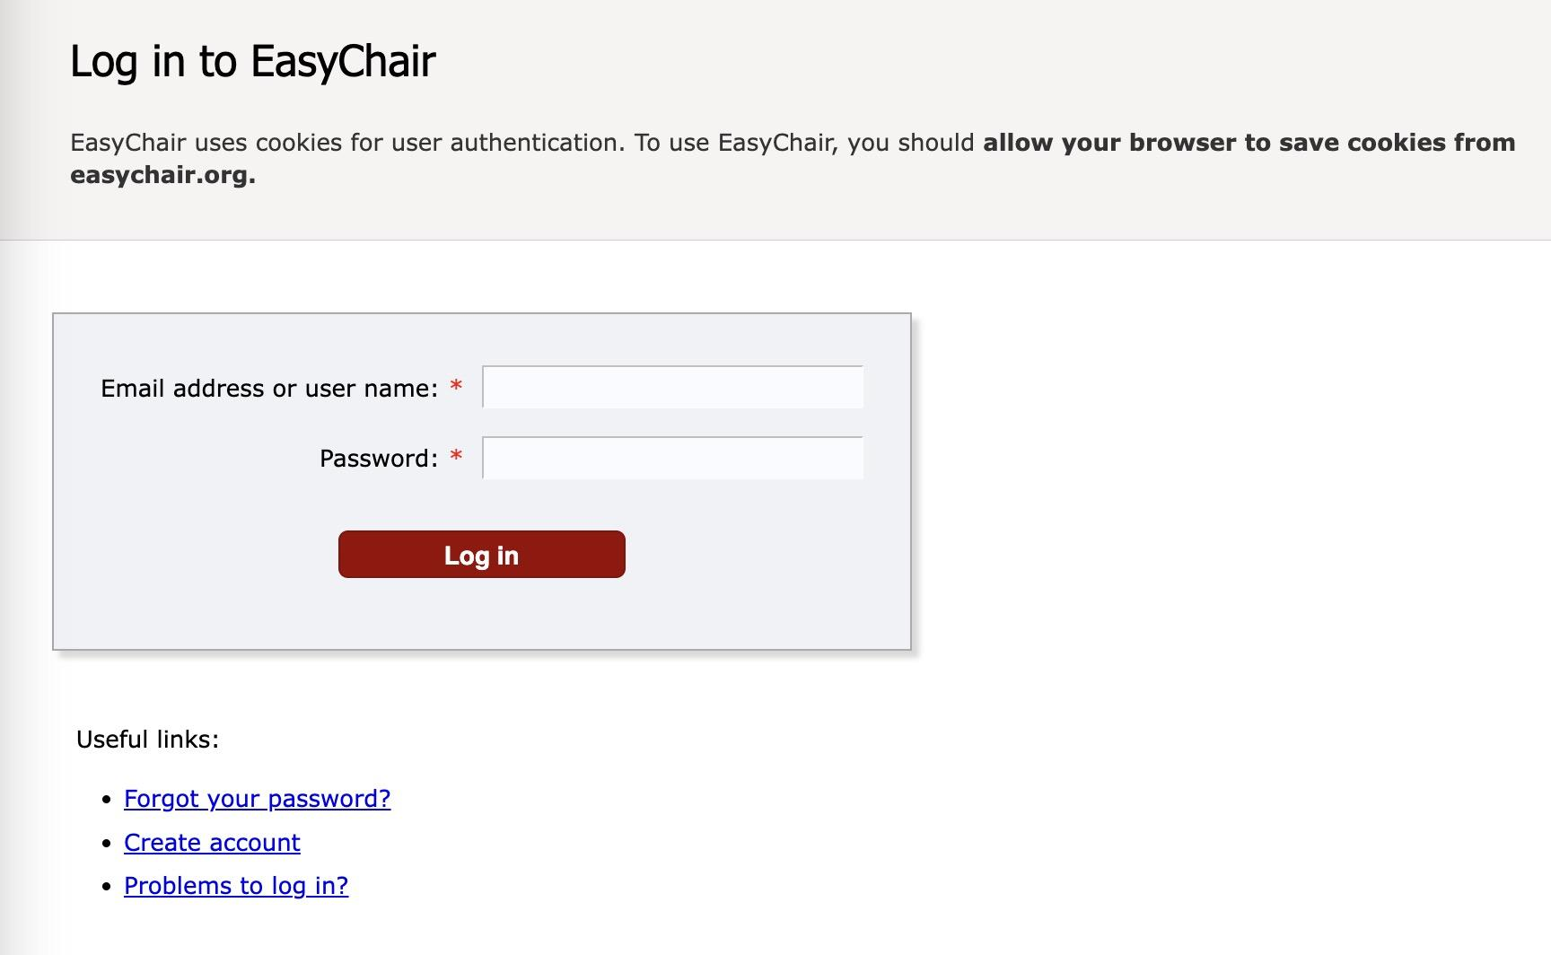
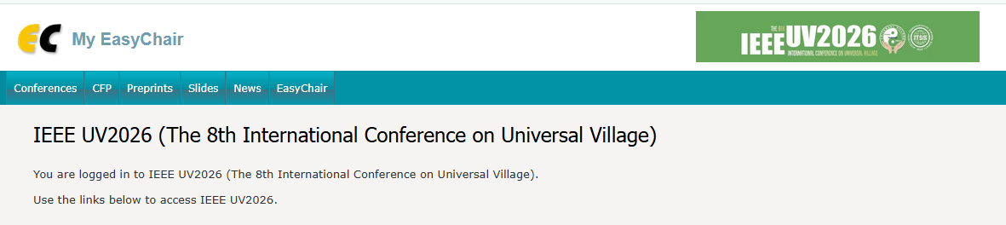
Account login (A)
Visit https://www.easychair.org/account/signin
Enter your session chair account and password. Click on the button “Log in”
Then you can Access UV2026 Publication System (https://easychair.org/conferences/?conf=ieeeUV2026)

Slide 4

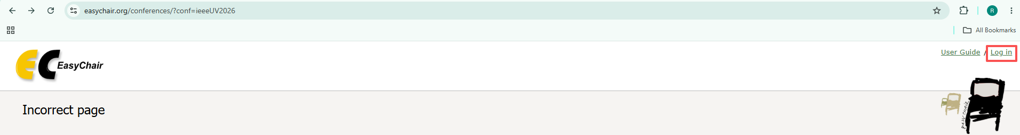
Account login (B)
Please make sure that you are logged in to EasyChair before accessing the IEEE UV2026 conference page (https://easychair.org/conferences/?conf=ieeeUV2026).
Otherwise, you may encounter the following error message.
Please click the “Log in” on the top right corner AND enter your account and password to log in.

Slide 5

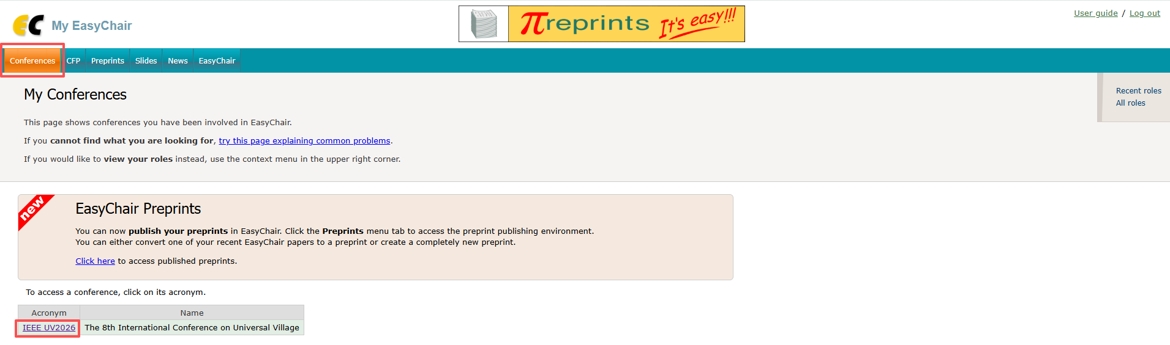

Account login (C)
b) After logging in, click on “Conferences” and then “IEEE UV2026” to access UV2026 Publication System

Slide 6
2. Assign papers to reviewers (A)
Please ask your reviewers to follow instructions from IEEE UV2026 Paper Review Instructions on EasyChair to create an EasyChair account of their own.
If your reviewers don’t have access to the EasyChair platform, please ask your session assistants to send an electronic copy of the paper and an offline review form to your reviewers. In this way, your reviewers will still be able to submit their comments through the form.

Slide 7
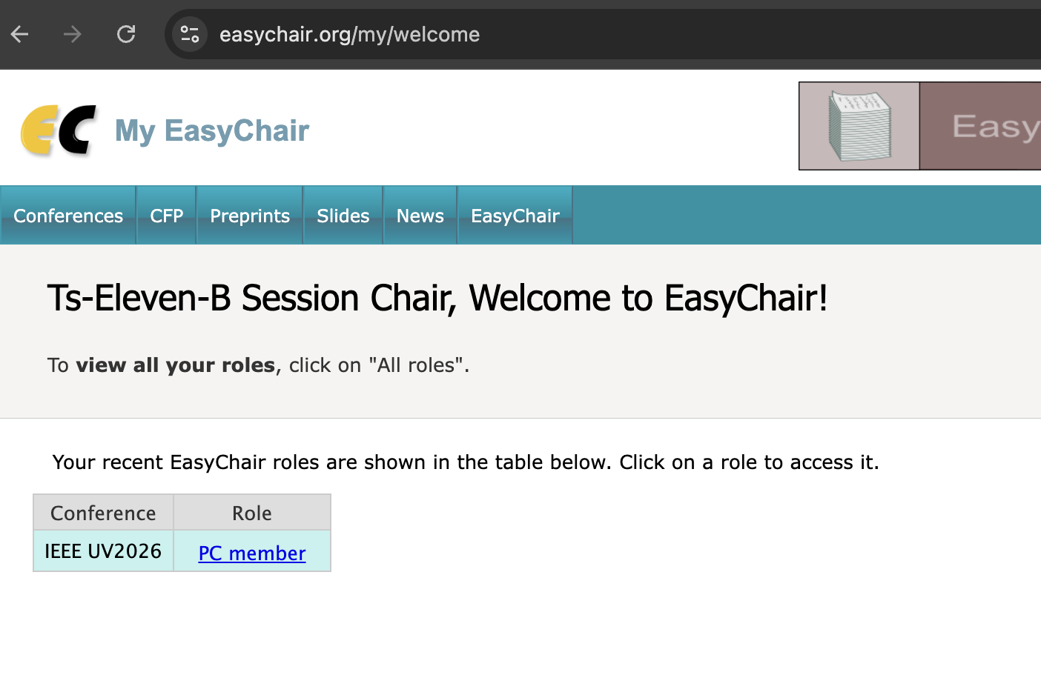

2. Assign papers to reviewers (B)
After logging into EasyChair using your session chair account through Log in
You will see the interface below; Now click “PC (Program Committee) member”
Please ensure that your display name matches the Session you are responsible for.

Slide 8
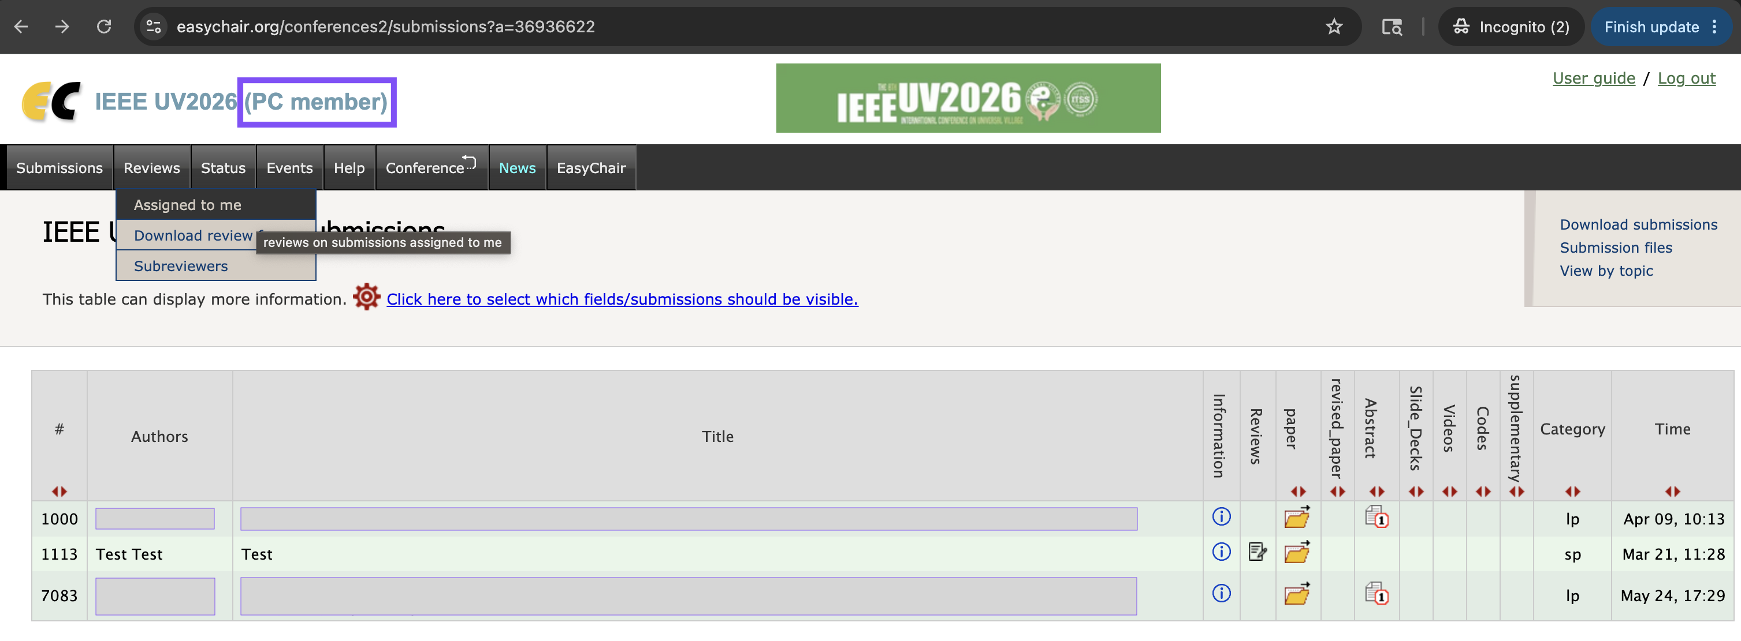

2. Assign papers to reviewers (C)
Access papers in your session
Click papers “Reviews” -> “Assigned to me”; Now, you will be able to see all the papers in your session

Slide 9

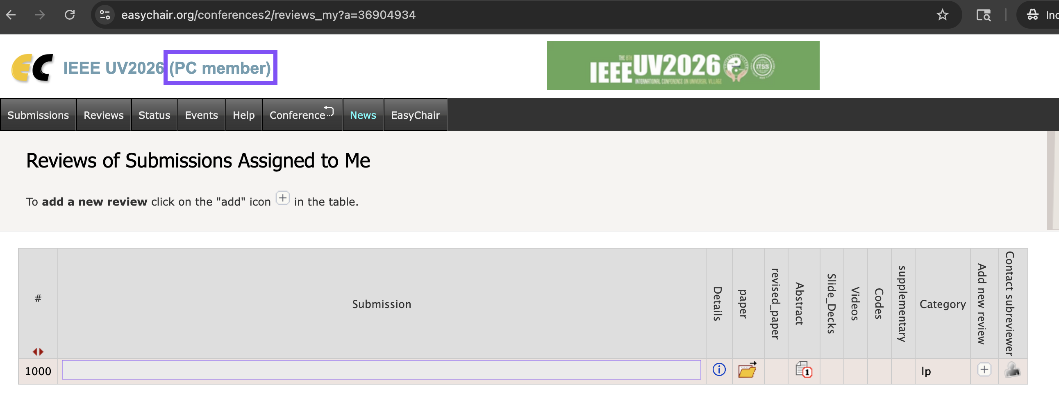

2. Assign papers to reviewers (D)
Click to assign the paper to a new reviewer

Slide 10
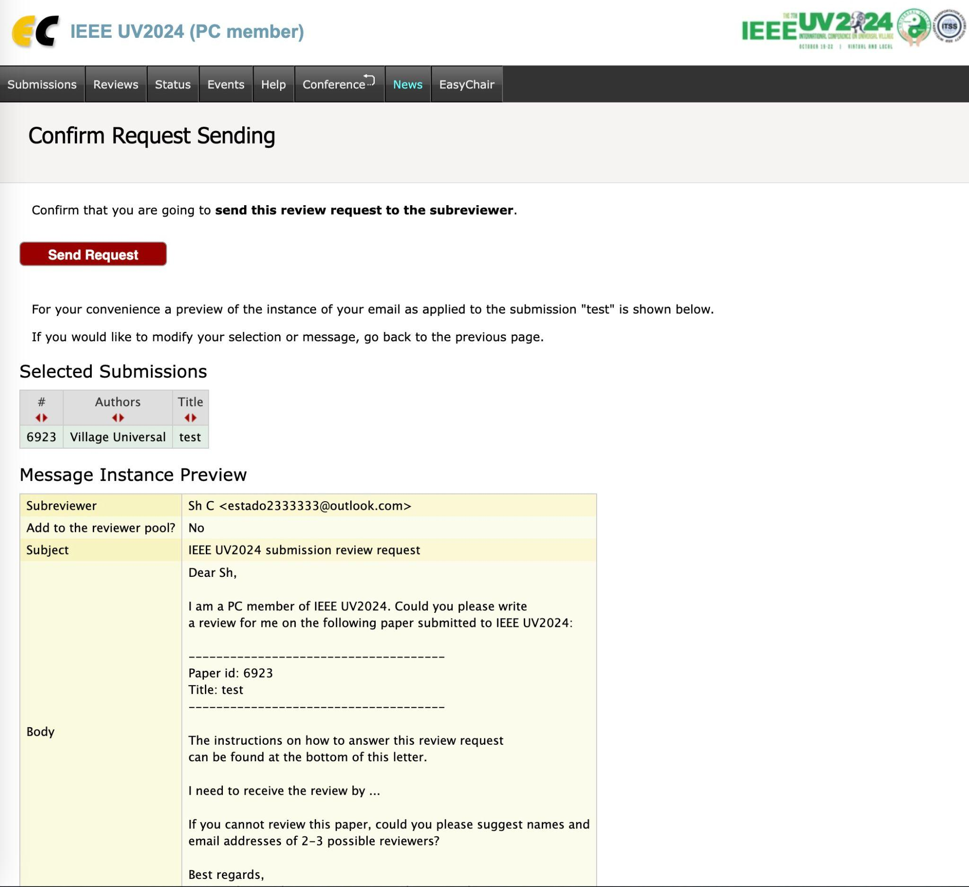
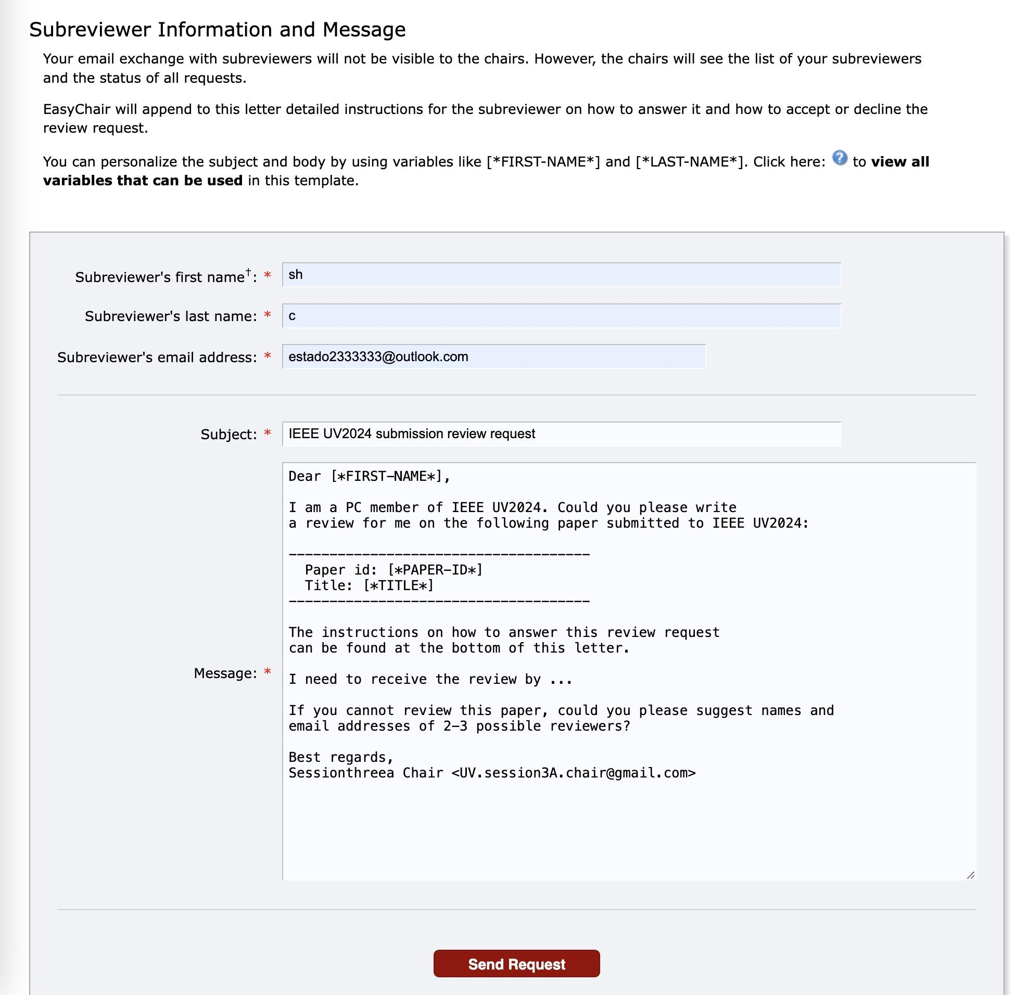
2. Assign papers to reviewers (E) Assignment using Easychair
Now, you will see the interface on the left;
Please fill in your reviewer’s information;
You can also personalize the subject and the content of the review request message that will be sent to your reviewers;
After finalizing all the information, please click “Send Request” and you will be led to the interface on the right;
Now, you can review the message to be sent out; You can click “Send Request” to send the review request message to your reviewer.

Slide 11
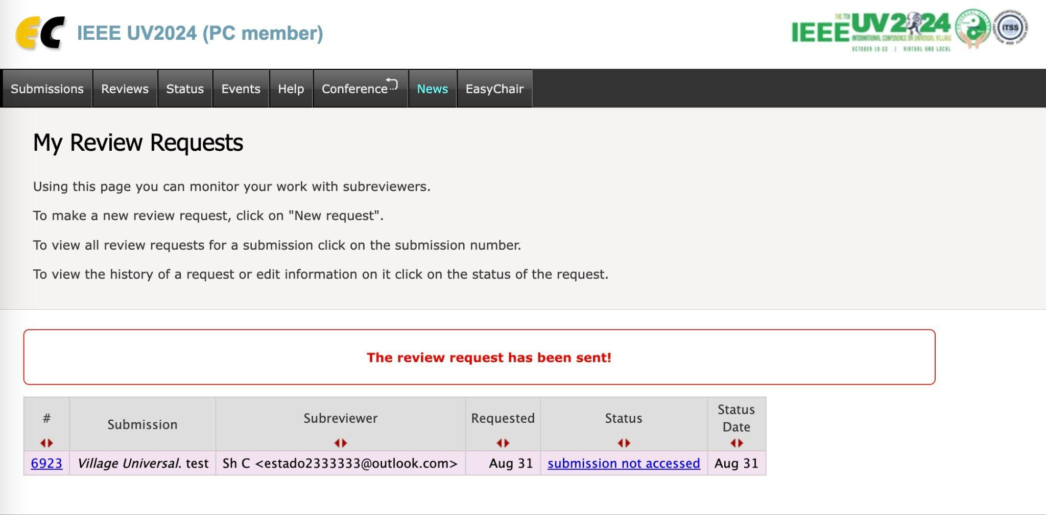
2. Assign papers to reviewers (F) You have now successfully sent a review request to your reviewer!

Slide 12
3. Paper review process (A)
Use the account of your session chair to log into EasyChair through Log in
After logging in, you will see the below interface; Now, click “PC (program committee) member”
Notes:
PC Member?

Slide 13
3. Paper review process (B)
Access reviews
Now, Click Reviews -> Assigned to me

Slide 14

3. Paper review process (C)
Find your assigned papers and click to download papers

Slide 15

3. Paper review process (D)
Click to start to review papers

Slide 16
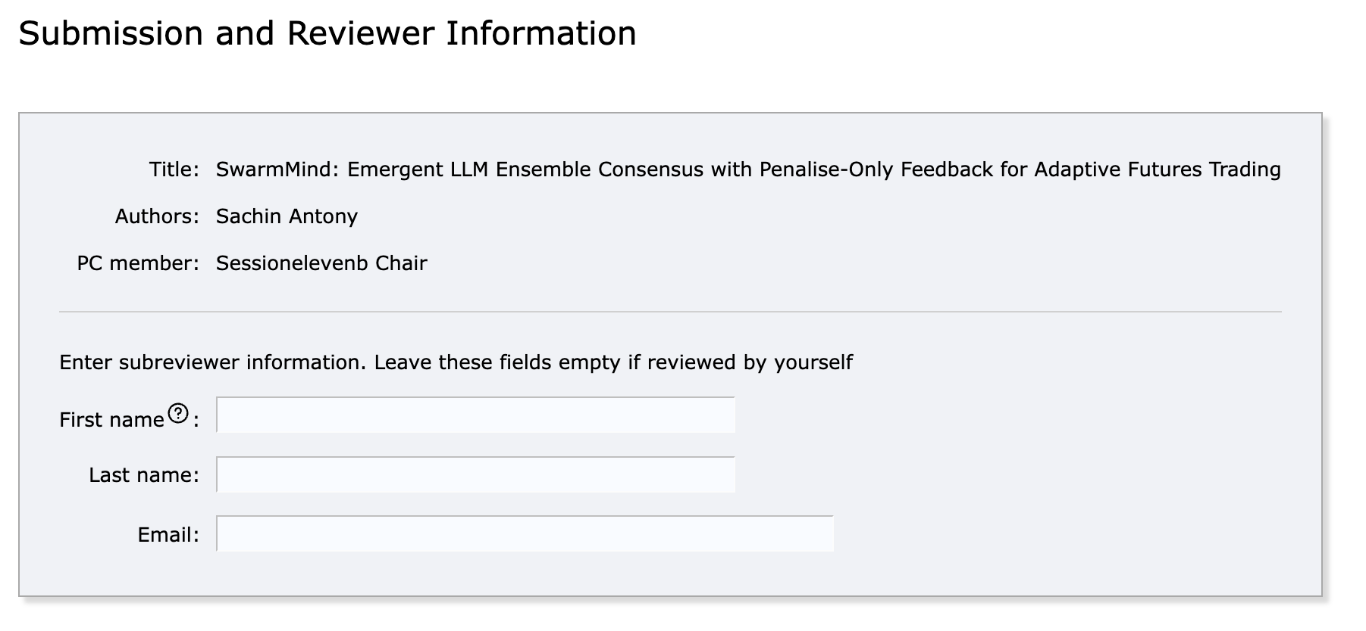
3. Paper review process (E)
Now, you will see the following interface
Please go ahead and fill in your information

Slide 17
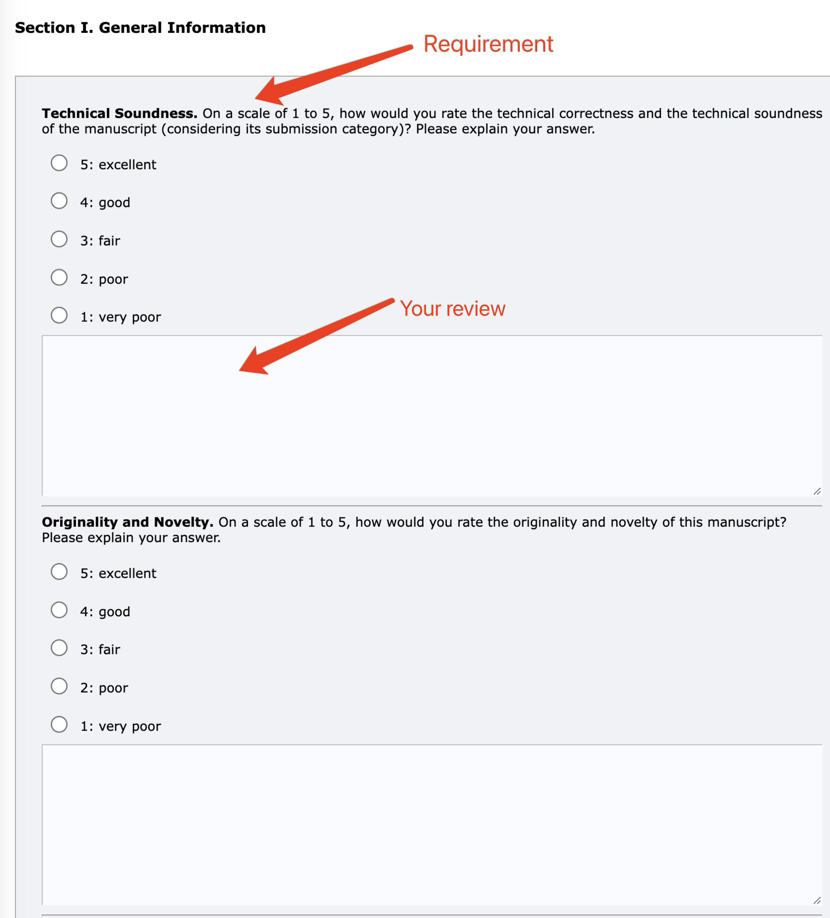

3. Paper review process (F) Evaluate the paper and Provide comments
After submitting your information, you will be able to start to evaluate the paper and provide comments according to the provided prompt.
After finishing reviewing the papers, you can click to submit the review

Slide 18
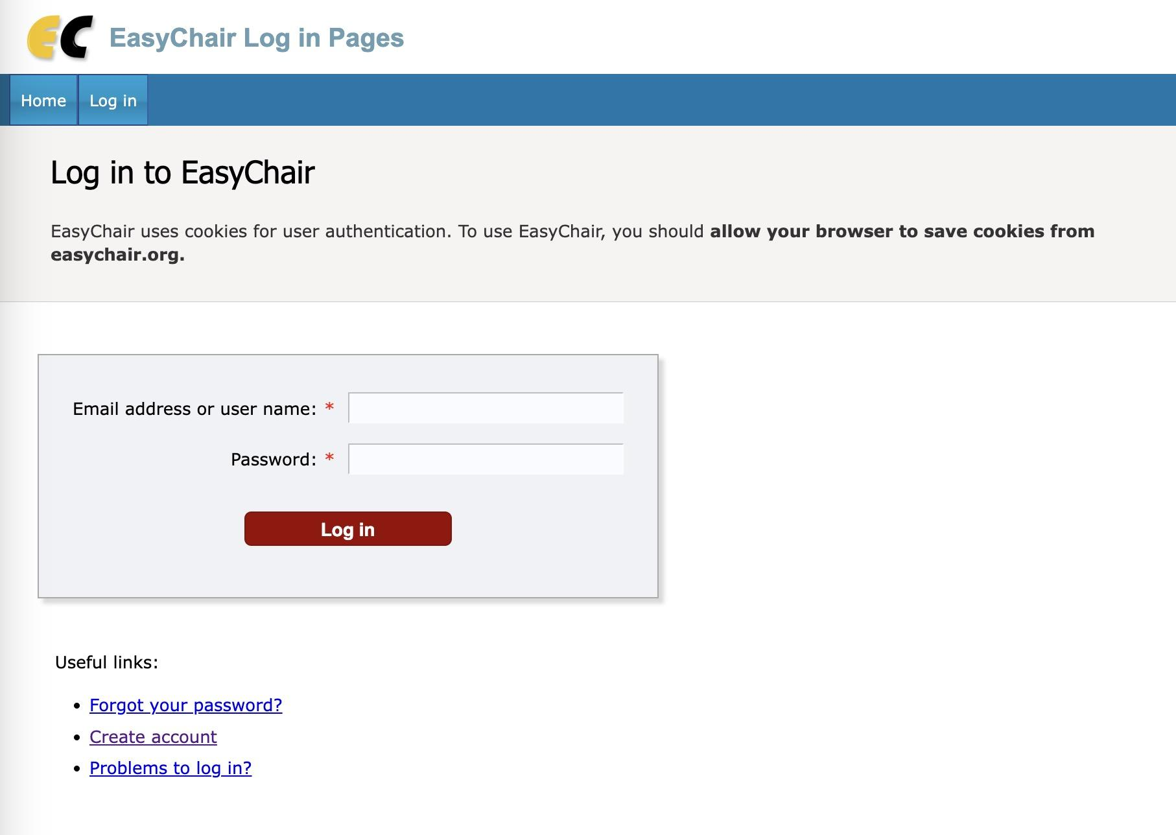
4. Check the review results (A)
Log in EasyChair with your session chair account Log in

Slide 19
4. Check the review results (B)
Click “PC member”

Slide 20
4. Check the review results (C)
Click papers “Reviews” -> “Assigned to me”; Now, you will be able to see all the papers in your session

Slide 21
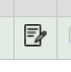
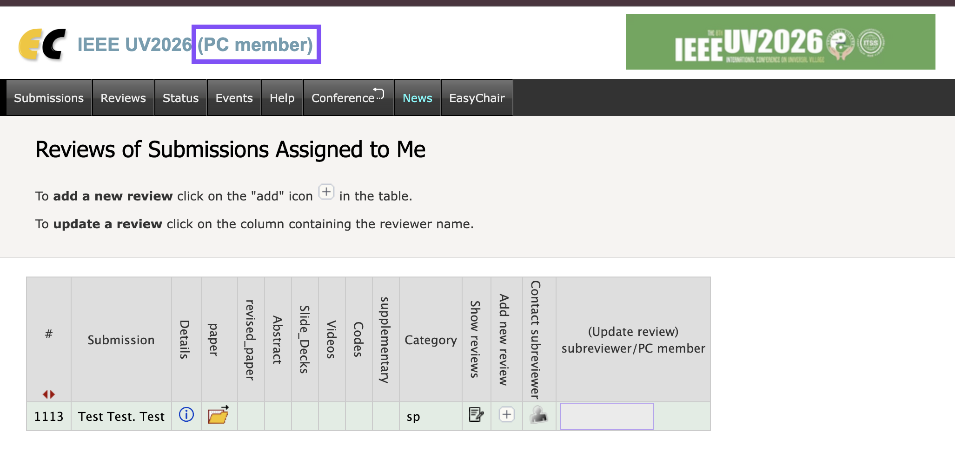

4. Check the review results (D)
Check the review result of the paper
Click under “Show reviews” to access the review results

Slide 22
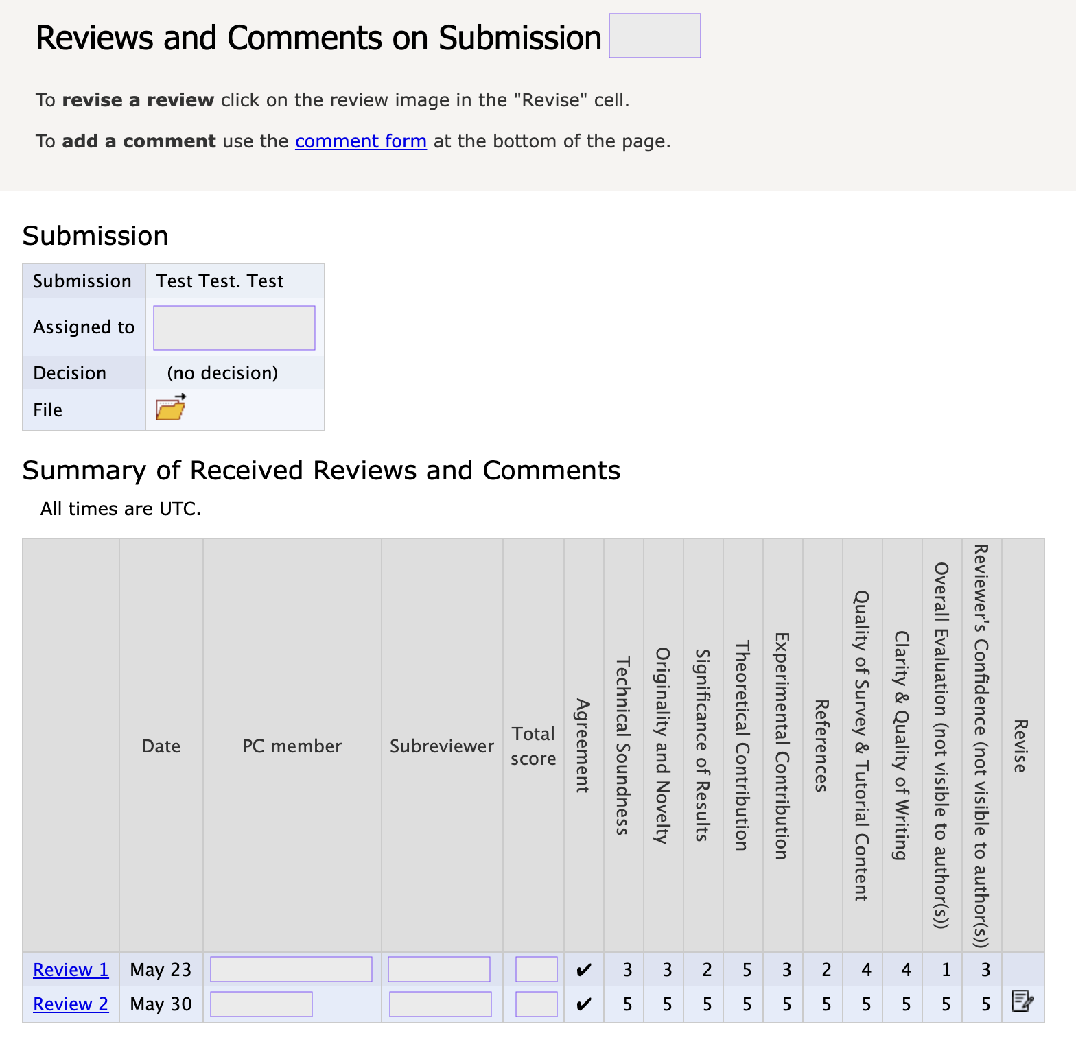
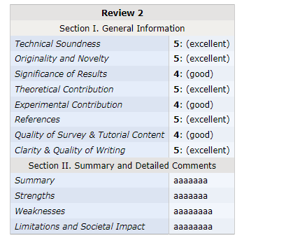
4. Check the review results (E)
See the review result of your paper

